Slide 1
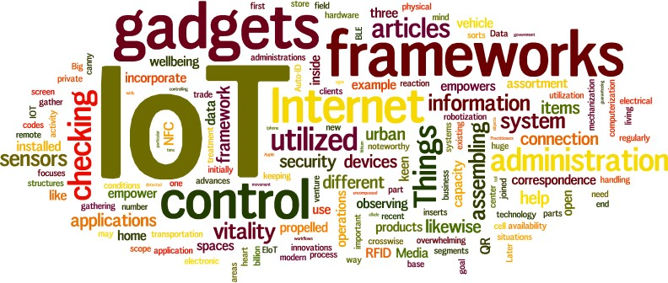
MQTT:
Message Queuing Telemetry Transport
1

Slide 2
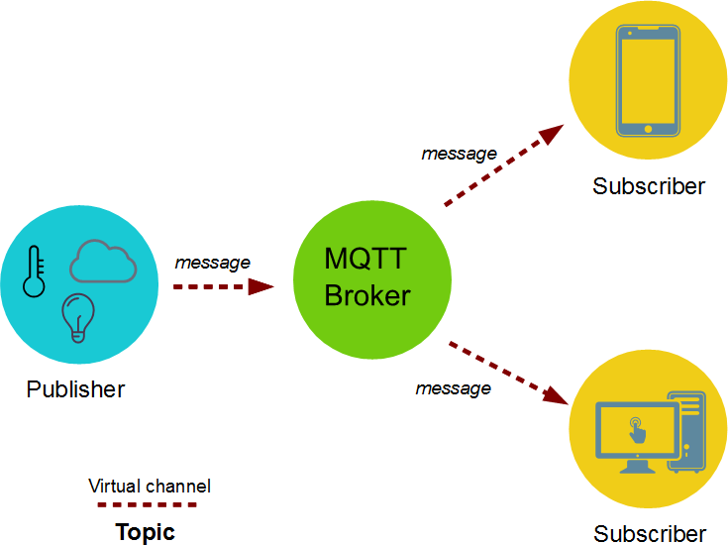
What is MQTT?
MQTT : Message Queueing Telemetry Transport protocol.
Reliable, Lightweight, Cost-effective protocol that transports messages between devices.
Suited for the transport of telemetry data (sensor and actuator data)
Invented by Andy Stanford Clark of IBM and Arlen Nipper of Arcom (now Eurotech) in 1999
Used by real-life IoT frameworks:
  Amazon Web Services (AWS),
  IBM WebSphere MQ,
  Microsoft Azure IoT,
  Facebook Messenger,
  etc.
MQTT Architecture
Example:
Light sensor continuously publish sensor data to the broker.
Building control application subscribes to light sensor data and so receives it from the broker. Then it decides to activate Camera.
The application sends an activation message to the camera node (i.e. actuator) through the broker.
2

Slide 3
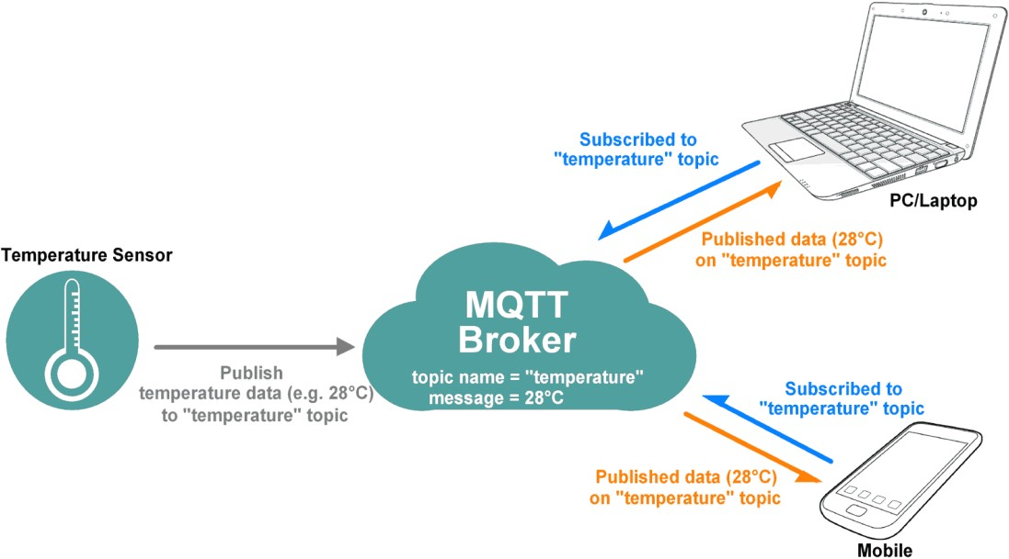
MQTT Characteristics
In 2013-14, MQTT was adopted and published as an official standard by OASIS
  OASIS: Organization for the Advancement of Structured Information Standard
MQTT was mainly designed for M2M communication
Publish / Subscribe (PubSub) model
  Decoupling of data producer (publisher) and data consumer (subscriber) through topics (message queues)
Asynchronous communication model with messages (events)
  Publisher and Subscriber need not be online at the same time
Low overhead (2 bytes header)
  Suitable for low network bandwidth applications
Runs on connection-oriented transport (TCP), but it will be used in conjunction with 6LoWPAN HC
(TCP header compression).
3

Slide 4
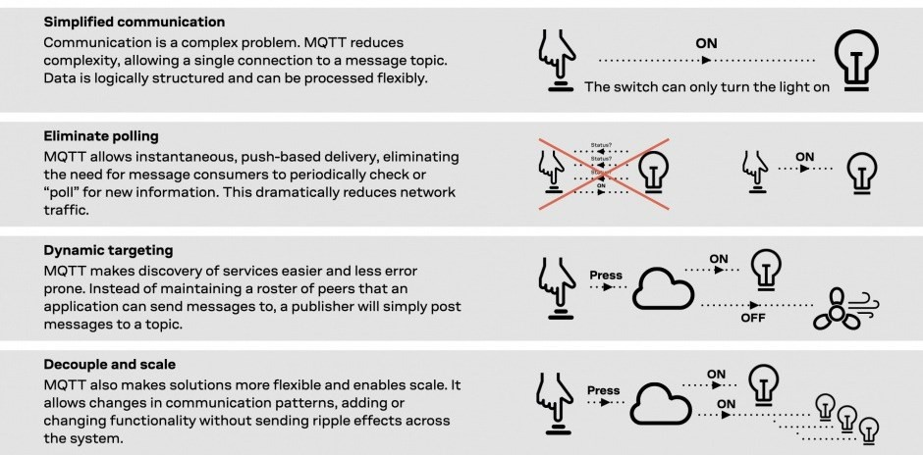
Advantages of MQTT
Source: https://www.u-blox.com/en/blogs/insights/mqtt-beginners-guide
4

Slide 5
Publish & Subscribe Messaging
A producer sends (publishes) a message (publication) on a topic (subject)
A consumer subscribes (makes a subscription) for messages on a topic (subject)
A message server / broker matches publications to subscriptions
Who will get the message ?
If no matches, the message is discarded
If one / more matches, the message is delivered to each matching subscriber/consumer
Topic
A topic forms the namespace in hierarchical with each “sub topic” separated by /
(forward slash)
➔ An example topic space :
  A house publishes information about itself on:
<country>/<region>/<town>/<postalcode>/<house no>/energyConsumption
<country>/<region>/<town>/<postalcode>/<house no>/solarEnergy
It subscribes for control commands:
<country>/<region>/<town>/<postalcode>/<house no>/thermostat/setTemp
5

Slide 6
Cont…
Wildcards
A subscriber can subscribe to an absolute topic OR can use wildcards:
  Single-level wildcards “+” can appear anywhere in the topic string For example:
Let the Topic: <country>/<region>/<town>/<postalcode>/<house no>/energyConsumption
    Energy consumption for 1 house in Hursley
      UK/Hants/Hursley/SO212JN/+/energyConsumption
    Energy consumption for all houses in Hursley
      UK/Hants/Hursley/+/+/energyConsumption
  Multi-level wildcards “#” must appear at the end of the string For example:
    Details of energy consumption, solar and alarm for all houses in SO212JN
      UK/Hants/Hursley/SO212JN/#
NOTE :
Wildcards must be next to a separator
Wildcards cannot be used when publishing
6

Slide 7
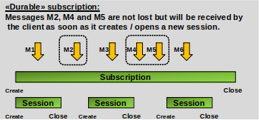
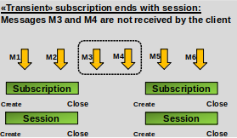
Cont…
A subscription can be durable or non-durable
Durable:
  Once a subscription is in place,
    A broker will forward matching messages to the subscriber immediately if the subscriber is connected.
    If the subscriber is not connected, messages are stored on the server/broker until the next time the subscriber connects.
Non-durable / Transient (i.e. subscription ends with client session):
  The subscription lifetime is the same as the time the subscriber is connected to the server / broker
7

Slide 8
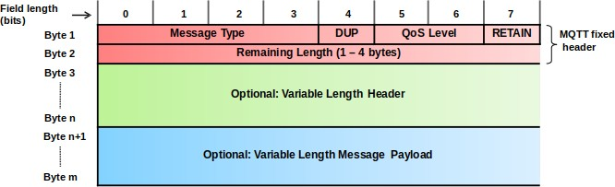
MQTT Message Format
Message Type: identifies the kind of MQTT packet within a message
DUP: Duplicate flag – indicates whether the packet has been sent previously or not
QoS Level: it allows to select different QoS level
Retain: this flag notifies the server to hold onto the last received PUBLISH message data
Remaining Length: specifies the size of optional fields
MQTT is lightweight
  because each packets consists of a 2-byte fixed header with optional variable header and payload fields
8

Slide 9
Cont…
Message header field | Description / Values
Message Type (4 bits) 14 message types, 2 are reserved | 0: Reserved | 8: SUBSCRIBE
 | 1: CONNECT | 9: SUBACK
 | 2: CONNACK | 10: UNSUBSCRIBE
 | 3: PUBLISH | 11: UNSUBACK
 | 4: PUBACK (Publish ACK) | 12: PINGREQ
 | 5: PUBREC (Publish Received) | 13: PINGRESP
 | 6: PUBREL (Publish Release) | 14: DISCONNECT
 | 7: PUBCOMP (Publish Complete) | 15: Reserved
DUP (1 bit) | Duplicate message flag. Indicates to the receiver that this message may have already been received. 1: Client or server (broker) re-delivers a PUBLISH, PUBREL, SUBSCRIBE or UNSUBSCRIBE message (duplicate message).
QoS Level (2 bits) | Indicates the level of delivery assurance of a PUBLISH message. 0: At-most-once delivery, no guarantees, «Fire and Forget». 1: At-least-once delivery, acknowledged delivery. 2: Exactly-once delivery.
RETAIN (1 bit) | 1: Instructs the server to retain the last received PUBLISH message and deliver it as a first message to new subscriptions.
Remaining Length (1-4 bytes) | Indicates the number of remaining bytes in the message, i.e. the length of the (optional) variable length header and (optional) payload.
9

Slide 10
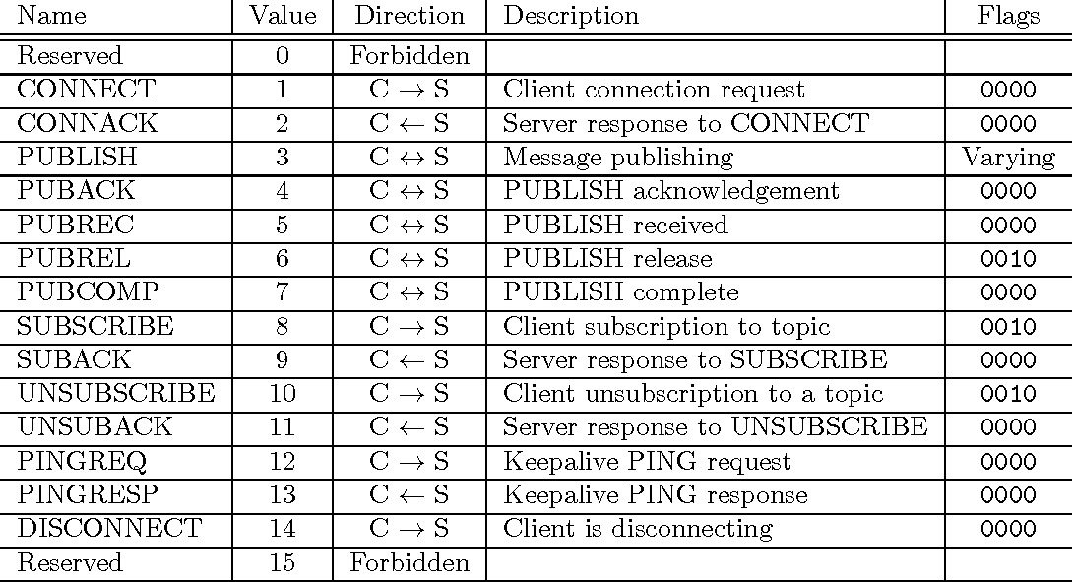
Message Types

Slide 11
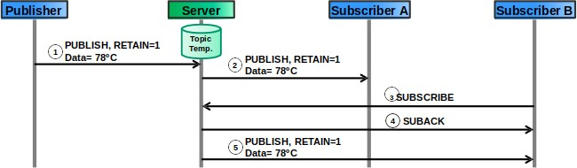
RETAIN
RETAIN=1 in a PUBLISH message instructs the server to keep the message for this topic.
When a new client subscribes to the topic, the server sends the retained message quickly.
Typical application scenarios:
  Clients publish only changes in data, so subscribers receive the last known good value.
Example:
  Subscribers receive last known temperature value from the temperature data topic.
  RETAIN=1 indicates to subscriber B that the message may have been published some time ago.

Slide 12
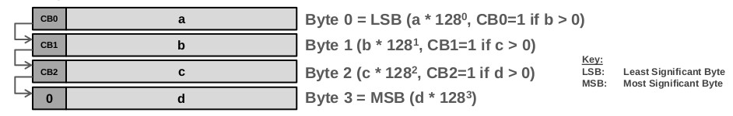
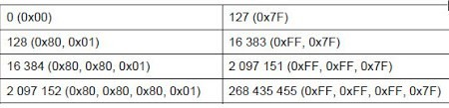
Remaining Length (RL)
The remaining length field encodes the sum of the lengths of:
  (Optional) variable length header
  (Optional) variable length payload
To save bits, RL is a variable length field with 1 to 4 bytes.
The most significant bit (msb) of a length field byte has the meaning continuation bit (CB).
If more bytes follow, it is set to 1.
RL is encoded as:: a * 128⁰ + b * 128¹ + c * 128² + d * 128³
and placed into the RL field bytes as follows:
7 bits
msb

Slide 13
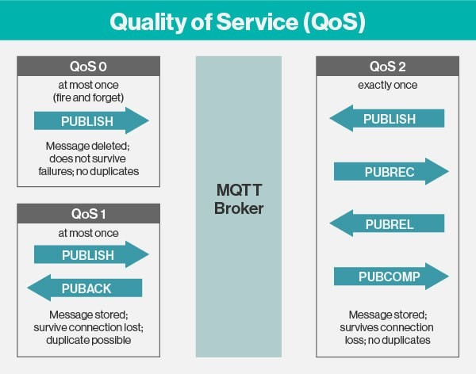
MQTT QoS
Even though TCP/IP provides guaranteed data delivery, data loss can still occur if a TCP connection breaks down and messages in transit are lost.
Therefore, MQTT adds 3 quality of service (QoS) levels on top of TCP
PUBREC (REC: received) Packet is the response to a PUBLISH Packet
at least once
PUBREL (REL: release) Packet is the response to a PUBREC Packet
PUBCOMP (COMP: complete) Packet is the response to a PUBREL Packet.

Slide 14
Cont…
QoS level 0:
At-most-once delivery («best effort»).
Messages are delivered according to the delivery guarantees of the underlying network (TCP/IP).
  Example application: Temperature sensor data which is regularly published. Loss of an individual value is not critical since applications (i.e. consumers of the data) will anyway integrate the values over time
QoS level 1:
At-least-once delivery.
Messages are guaranteed to arrive, but there may be duplicates.
  Example application: A door sensor senses the door state. It is important that door state changes (closed->open, open->closed) are published losslessly to subscribers (e.g. alarming function). Applications simply discard duplicate messages by comparing the message ID field.
QoS level 2:
Exactly-once delivery.
This is the highest level that also incurs most overhead in terms of control messages and the need
for locally storing the messages.
Exactly-once is a combination of at-least-once and at-most-once delivery guarantee.
  Example application: Applications where duplicate events could lead to incorrect actions, e.g. sounding an alarm as a reaction to an event received by a message. So, it avoids duplicate.

Slide 15

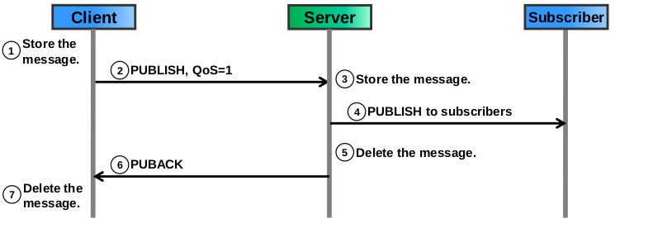
PUBLISH msg flow
QoS level 0:
With QoS level 0, a message is delivered with at-most-once delivery semantics («fire-and-forget»).
QoS level 1:
QoS level 1 affords at-least-once delivery semantics. If the client does not receive the PUBACK in time, it re-sends the message.

Slide 16
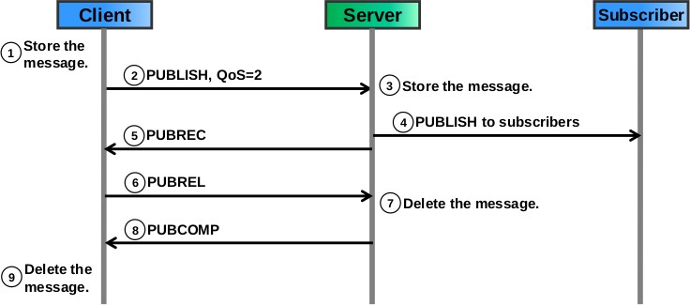
Cont…
QoS level 2:
QoS level 2 affords the highest quality delivery semantics exactly-once, but comes with the cost of
additional control messages.

Slide 17
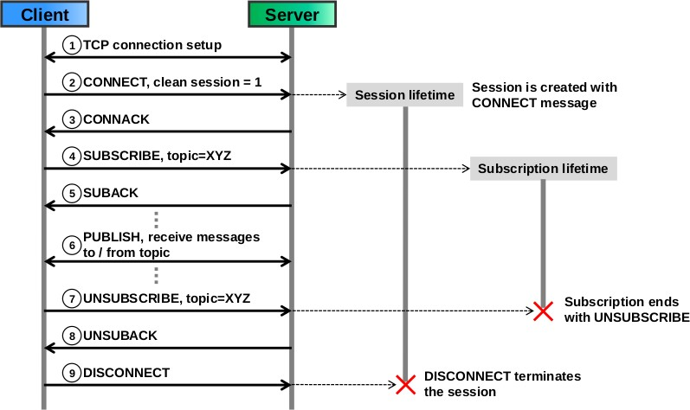
Example: CONNECT & SUBSCRIBE msg flow
Case 1:
Session/connection and subscription setup with clean session flag = 1 (non-durable subscription)

Slide 18
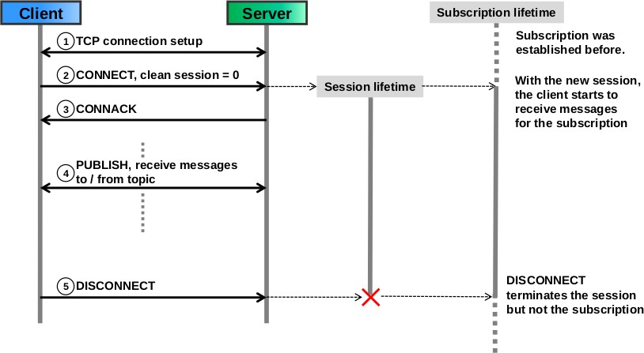
Cont…
Case 2:
Session/connection and subscription setup with clean session flag = 0 (durable subscription)

Slide 19
What is MQTT-SN?
MQTT-SN (MQTT for sensor networks) is a variant of MQTT that has been optimized for use in low power environments such as sensor networks, as the name suggests.
SN adds extra functionality for use cases where lower power is required.
QoS mode - 1: allows for fire-and-forget messaging
Topic aliases: allows for simplified publishing and reduced data overheads
Sleep mode (disconnected sessions): allows messages to be queued on the broker while the remote Thing or device is powered off

Slide 20
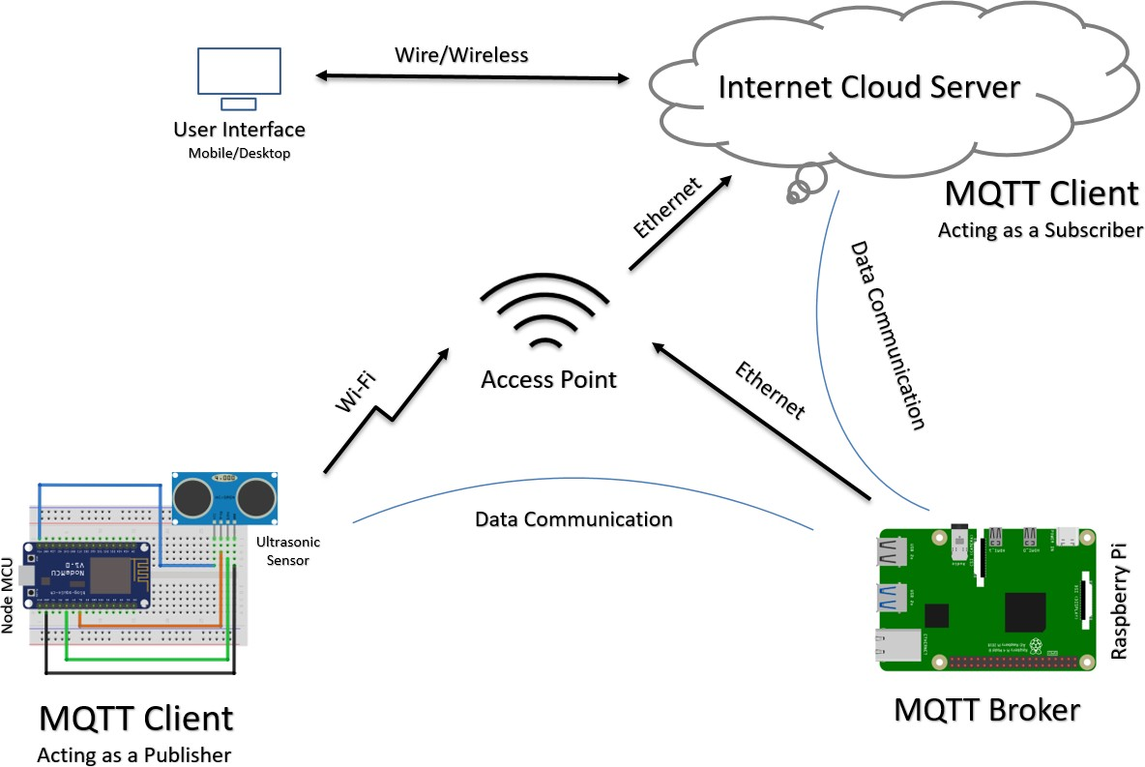
Demo using MQTT Protocol
Send Sensor values to Cloud using MQTT Protocol:
The Ultrasonic Sensor reads the distance between itself & the object
Sends the measured distance to the cloud server using MQTT protocol.
Here, the cloud is ThingSpeak.com

Slide 21
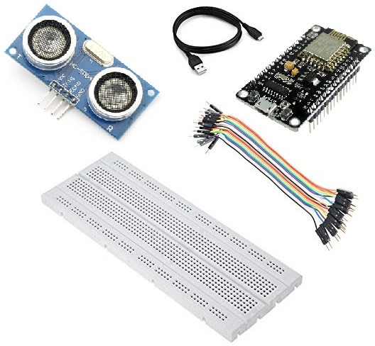
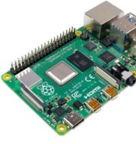

Requirements
Hardware
ESP8266 NodeMCU
Breadboard
Jumper Wires
HC-SR04 Ultrasonic Sensor
Raspberry Pi
Software
Arduino IDE
Fritzing
Cloud Platform
ThingSpeak Account
ThingSpeak is an IoT analytics PaaS that allows you to aggregate, visualize, and analyze live data streams

Slide 22
ESP8266 NodeMCU: Libraries
The ESP8266 NodeMCU requires certain libraries for optimal use of the board.
PubSubClient – It is required for the MQTT Messaging.
ThingSpeak – It is a communication library for supporting to send data to the cloud.
ESP8266WiFi – It is required to use the Wi-Fi capabilities of the NodeMCU.
Step to install above libraries for the programming part:
Open Arduino IDE
Move on to Tools
Manage Libraries…
Search and install the above mentioned libraries

Slide 23
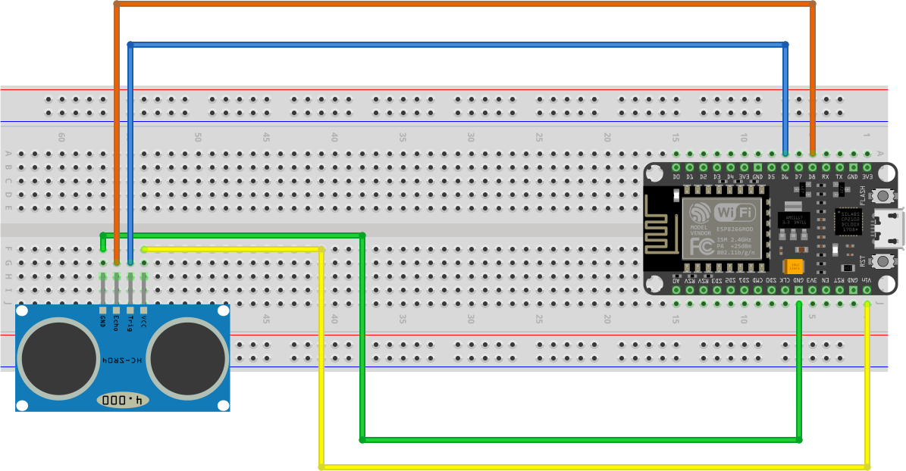
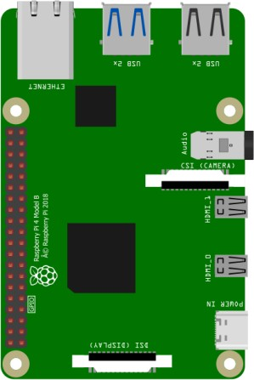
Setup Connections
Subscribe to Topic “distance”
Cloud
Server
TP-LINK_ED34
Publish on Topic “distance”
MQTT Client (Subscriber)
MQTT Client (Publisher)
MQTT Server (Broker) "192.168.0.104"

Slide 24
Programming ESP8266
#include <ESP8266WiFi.h>
#include <PubSubClient.h>
#define TRIGGER D6 #define ECHO D8 long duration, cm;
const char* ssid = "TP-LINK_ED34";
const char* password = "48193580";
//Raspberry Pi IP Address
const char* mqtt_server = "192.168.0.104";
WiFiClient espClient;
PubSubClient client(espClient);
void setup_wifi () { delay(10); Serial.println();
Serial.print("Connecting to "); Serial.println(ssid);
WiFi.begin(ssid, password);
while (WiFi.status() != WL_CONNECTED) { delay(500);
Serial.print(".");
}
Serial.println("");
Serial.print("WiFi connected - ESP IP address: ");
Serial.println(WiFi.localIP());
}

Slide 25
Cont…
void callback (String topic, byte* message,
unsigned int length)
{
Serial.print("Message arrived on topic: "); Serial.print(topic);
Serial.print("Message: ");
String messageTemp;
for (int i = 0; i < length; i++) { Serial.print((char)message[i]); messageTemp += (char)message[i];
}
Serial.println();
}
A callback is a function that is passed as an argument to another function.
void reconnect ()
{
// Loop until we're reconnected while (! client.connected ()) {
Serial.print("Attempting MQTT connection...");
if (client.connect("ESP8266Client"))
{
Serial.println("connected");
client.subscribe("esp8266/4");
}
else {
Serial.print("failed, rc="); Serial.print(client.state()); Serial.println(" try again in 5 seconds"); delay(15000);
}
}
}

Slide 26
Cont…
void setup () { Serial.begin(115200); pinMode(TRIGGER,OUTPUT); pinMode(ECHO,INPUT);
digitalWrite(TRIGGER, LOW); delayMicroseconds(2); digitalWrite(TRIGGER, HIGH); delayMicroseconds(10); digitalWrite(TRIGGER, LOW);
setup_wifi ();
duration = pulseIn(ECHO, HIGH);
client.setServer (mqtt_server, 1883);
cm = duration / 29 / 2;
static char distanceincm[7];
client.setCallback (callback);
}
dtostrf(cm, 6, 2, distanceincm);
client.publish("/esp8266/distance", distanceincm);
void loop () {
if (! client.connected ()) {
reconnect();
}
if(! client.loop() ) client.connect("ESP8266Client");
Serial.print("Distance: "); Serial.print(cm); Serial.print("cm"); Serial.println(); delay(5000);
}

Slide 27
Programming R. Pi
import paho.mqtt.client as mqtt
import urllib3 # powerful HTTP client for Python
myAPI = 'SMLI56456456RHUB'
baseURL = 'https://api.thingspeak.com/update?api_key=%s'
% myAPI
val=''
http = urllib3.PoolManager()
def on_connect (client, userdata, flags, rc): print("Connected with result code "+ str(rc)) client.subscribe("/esp8266/distance")
def on_message (client, userdata, message): print("Received message '" + str(message.payload) +
"' on topic '" + message.topic)
distance = 0
if message.topic == "/esp8266/distance": print("Distance updated")
distance = str(message.payload, 'UTF-8') distance = distance.strip() print(distance)
global val
val = distance
if val != '' :
conn = http.request('GET', baseURL +'&field1=%s'%(val)) print(conn.status)
conn.read() conn.close() val = ''
def main():
mqtt_client = mqtt.Client() mqtt_client.on_connect = on_connect mqtt_client.on_message = on_message
mqtt_client.connect ('localhost', 1883, 60)
# Connect to the MQTT server and process messages in a
background thread.
mqtt_client.loop_start()
if name == ' main ': print('MQTT to InfluxDB bridge') main()

Slide 28
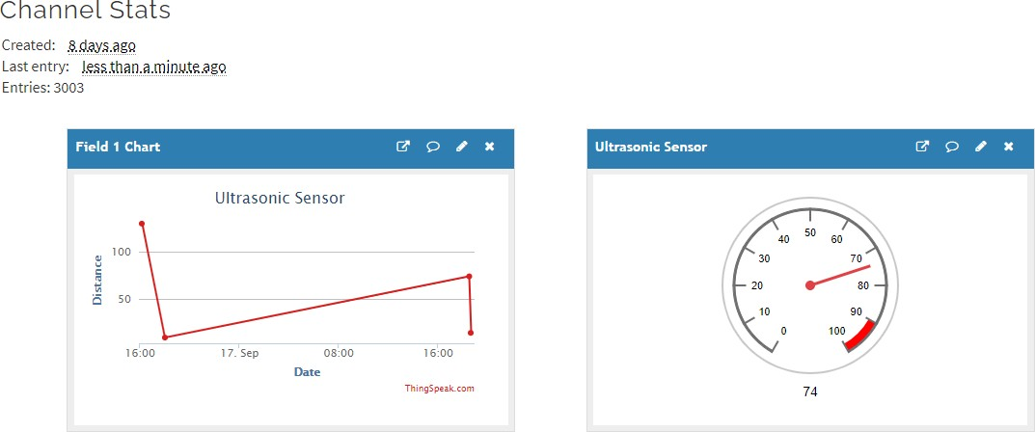
ThingSpeak Cloud Dashboard

Slide 29
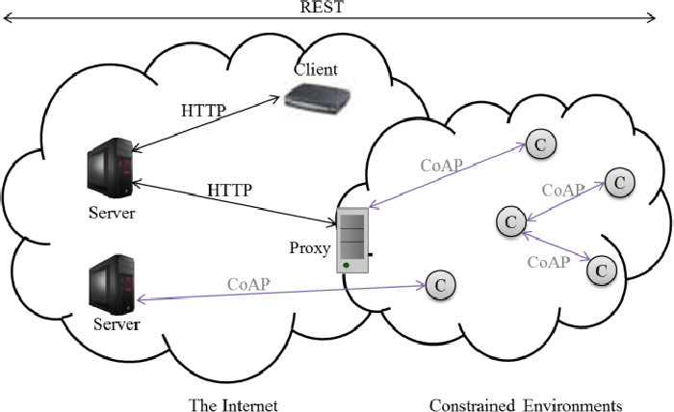
What is CoAP
CoAP - Constrained Application Protocol.
Specialized web transfer protocol.
Devised for constrained and low power
networks.
CoAP is an application layer protocol (similar as HTTP).
Inspired from HTTP, it follows the request- response pattern
CoAP has a transparent mapping to HTTP.
CoAP protocol spec is specified in RFC 7252.

Slide 30
Characteristics of CoAP
It is very efficient RESTful protocol.
It is Embedded web transfer protocol
Low parsing complexity.
Proxied to/from HTTP.
  GET, POST, PUT and DELETE methods are used.
  Uses subset HTTP response codes.
  URI is supported.
Low header overhead
It uses small and simple 4 byte header.
Supports binding to UDP, and TCP.
DTLS based certificate security is used.
What is REST?
Representational State Transfer (REST) is a software architecture that imposes conditions on how an API should work.
API developers can design APIs using several different architectures. APIs that follow the REST architectural style are called REST APIs or RESTful web APIs.
Some of the constraints of the REST
architectural style:
  Uniform interface
  Statelessness
  Cacheability
  Code on demand
  Layered system
  Etc.

Slide 31
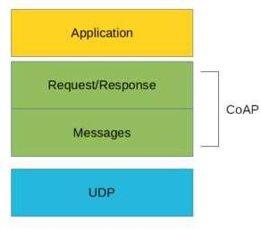
CoAP Structure
There are two different layers that make CoAP Protocol:
  Message
  Request/Response.
The Messages layer
  deals with UDP
  deals with asynchronous messages.
  is meant for Re-transmitting lost packets.
Message layer supports four types of messages:
Confirmable (CON)
Non-confirmable (NON)
Acknowledgment (ACK)
Reset (RST)
For Request
For Response
The Request/Response layer
  manages request/response interaction based on request/response messages.
Request/Response layer uses different methods
  Request Methods: GET, POST, PUT, and DELETE.
  Response Methods: 2.xx (success), 4.xx (client error), 5.xx (server error).

Slide 32
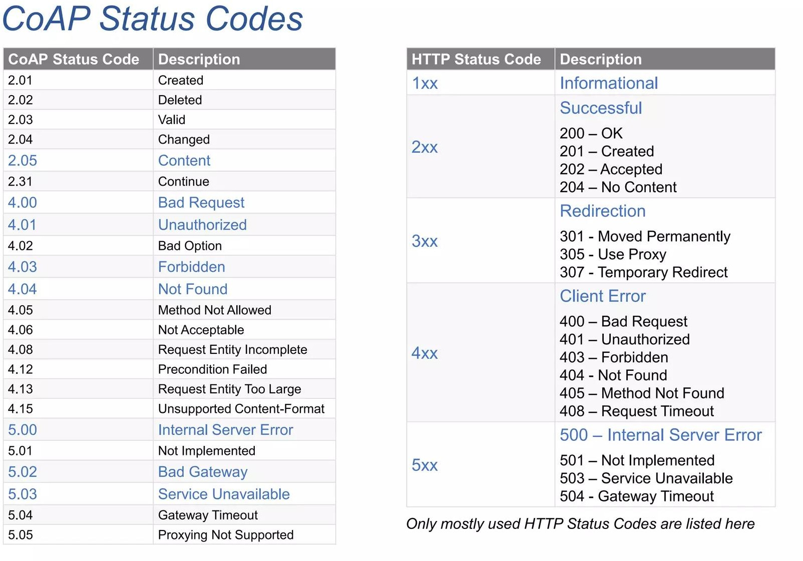
CoAP Status Codes in Response
Source: https://www.slideshare.net/aniruddha.chakrabarti/coap-web-protocol-for-iot

Slide 33
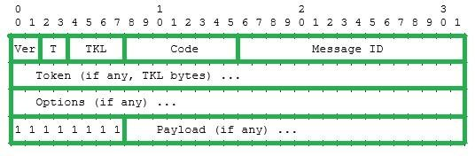
CoAP Message Format
Ver (2 bit): indicating the CoAP version.
T (2 bit): indicating the message type
  Confirmable (CON), Non-confirmable (NON), Acknowledgement (ACK), Reset (RST)
TKL (4 bit): Specifies the size (0-8 bytes) of the Token field
Token (0-8 byte): correlates requests and responses
Code (8 bit): indicates
request method for a request message,
response code for a response message.
e.g: GET is the request method
e.g. 2.05 is the response code
Message ID (16 bit):
  Detects message duplication
  Used to match ACK and RST message types to CON and NON message types.

Slide 34
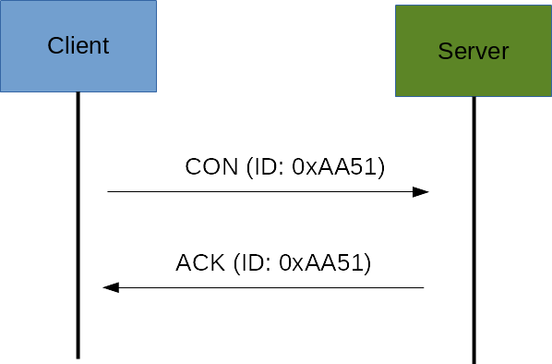
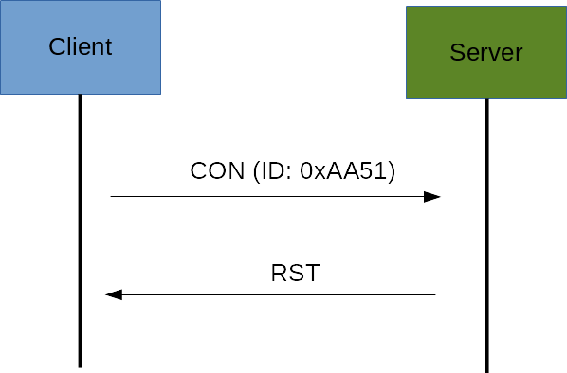
CoAP Messaging Model
CoAP deals with UDP for exchanging messages between endpoints.
Each CoAP message has a unique ID
Unique ID is useful to detect message duplicates.
Reliable messaging is obtained using a Confirmable message (CON).
  A CON message is sent again and again until the other party sends an acknowledge (ACK) message or
negative acknowledgement through reset message (RST).
    The ACK message contains the same ID of the CON message
    If the server has troubles managing the incoming request, send back a Reset message (RST) instead of the ACK.
    Retransmissions are made until all attempts are exhausted

Slide 35
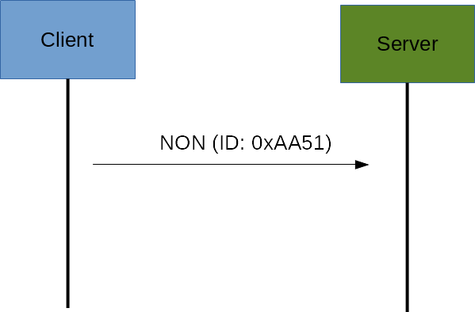
Cont…
Non-confirmable (NON) messages don’t require an ACK by the server.
They are unreliable messages or in other words messages that do not contain critical information that
must be delivered to the server.
  Example : Messages that contain sensed values from sensors.
  Even if these messages are unreliable, they have a unique ID.

Slide 36
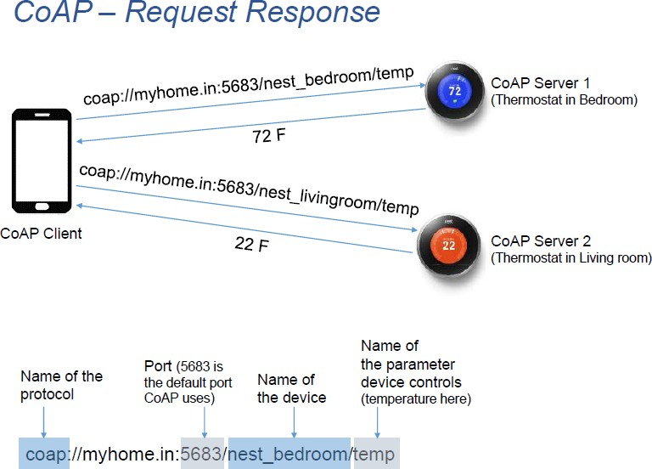
CoAP Request/Response Model
The CoAP Request/Response is the second layer in the CoAP Abstraction layer.
The request is sent using a Confirmable (CON) or Non-confirmable (NON) message.
There are several scenarios (e.g. Piggy-Backed, Separate Response) depending on if the server can
answer immediately to the client request or if not available.
CoAP URI:

Slide 37
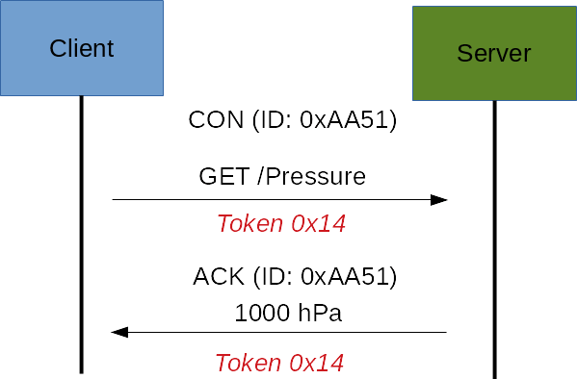
Cont…
If the server can answer immediately to the client request (Piggy-Backed response)
If the request is carried using a Confirmable message (CON).
  the server sends back an ACK message to client containing the response or the error code.
The Token is different from the Message-ID and it is used to match the request and the response.

Slide 38
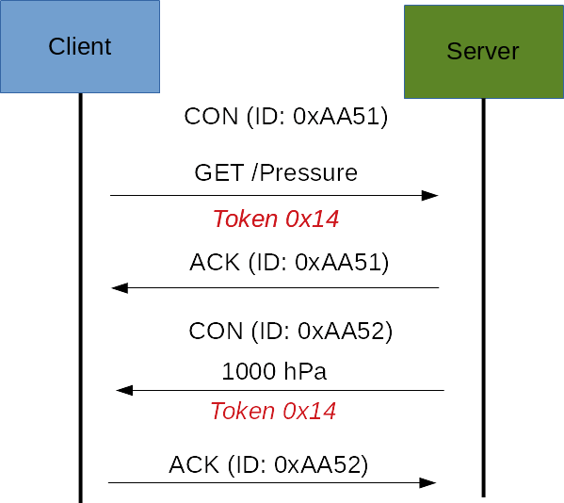
Cont…
If the server can’t answer immediately to the request coming from the client (Separate Response).
It sends an ACK message with an empty response.
When response is available, then the server sends a new CON message to the client containing the
response.
At this point, the client sends back an ACK message.

Slide 39
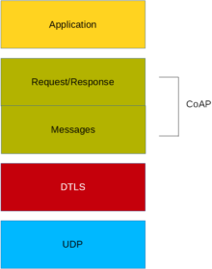
CoAP Security Aspects
CoAP uses UDP to transport information.
CoAP relies on UDP security aspects to protect the information.
As HTTP uses TLS over TCP, CoAP uses Datagram TLS over UDP. DTLS supports RSA, AES.
In some constrained devices, some of
DTLS cipher suits may not be available.
Some cipher suites introduces more complexity and constrained devices may not have resources enough to manage it.

Slide 40
CoAP Vs. MQTT
MQTT uses a publisher -subscriber. • CoAP uses a request-response paradigm
MQTT uses a central broker to dispatch messages coming from the publisher to the clients.
CoAP is essentially a one-to-one protocol very similar to the HTTP protocol.
MQTT is an event-oriented protocol.
While CoAP is more suitable for state transfer.
MQTT uses Asynchronous messaging.
CoAP uses both Asynchronous & Synchronous messaging

Slide 41
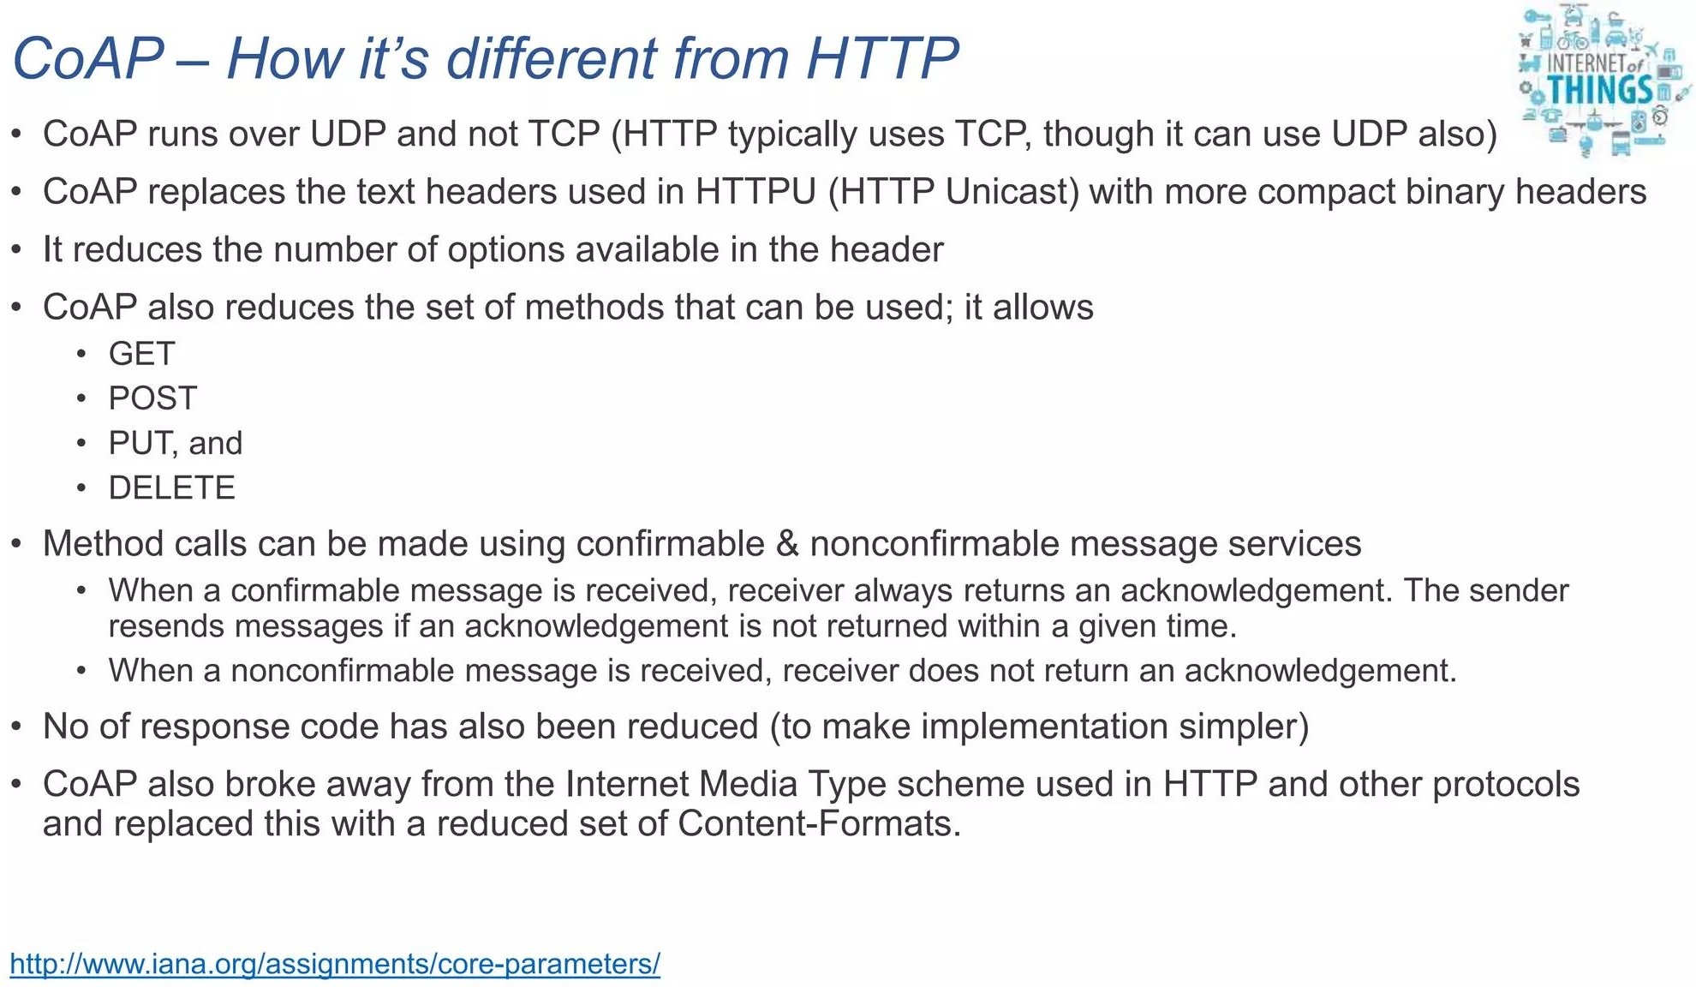
CoAP vs. HTTP

Slide 42

Thanks!

